Slide 1
The Application of Polyelectrolyte Self-Consistent Field Theory to Neurofilament Brushes
Takashi Yokokura
Experimental Collaborator: Erika Ding, PhD Candidate in the Dr. Sanjay Kumar Group
11/18/2021

Slide 2
Overview
Review of SCFT
Neurofilament brush
Application of SCFT
Application to Real-world systems

Slide 3
Overview
Review of SCFT
Self-consistent Field Equations
Single chain propagator, q(r, s)
Neurofilament brush
Application of SCFT
Application to Real-world systems

Slide 4
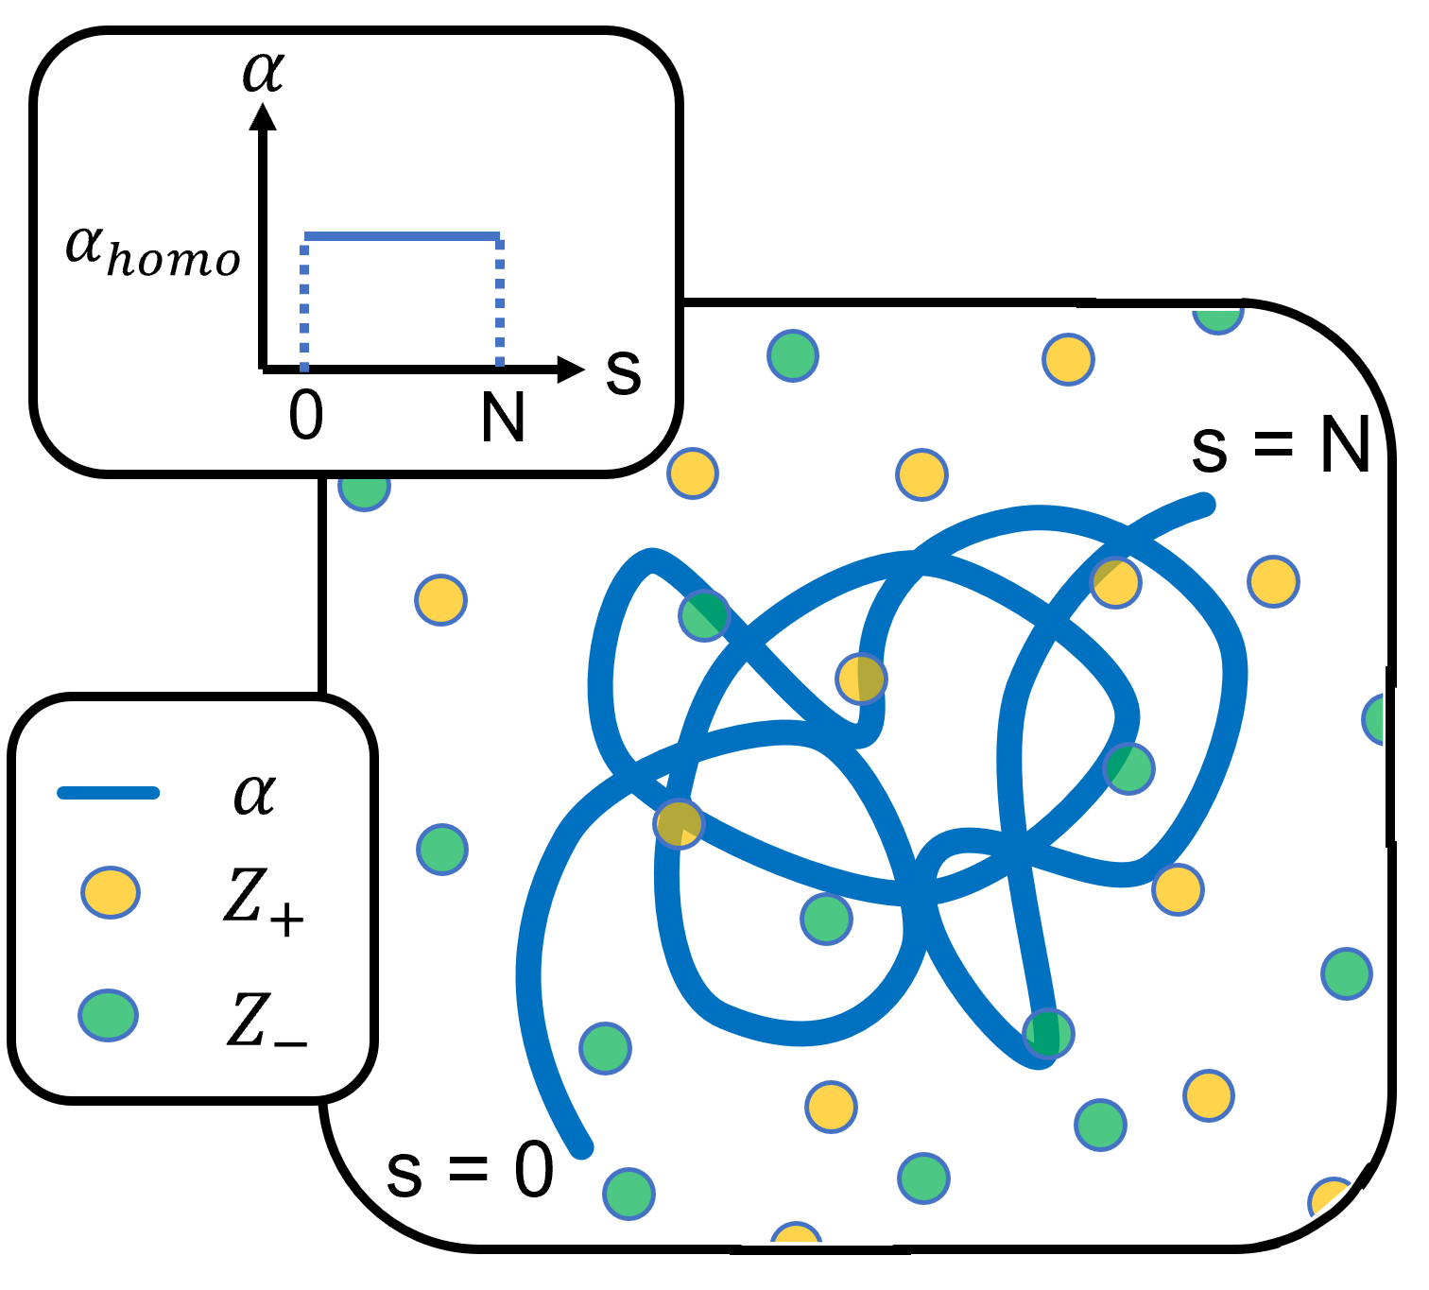
Ensemble
Grand canonical in solvent and salt ions
Canonical in polyelectrolye
Today’s talk will be focused on a strictly 1D, cartesian coordinate
All information in the x-y plane will be averaged
More on this assumption when discussing interested system

Slide 5
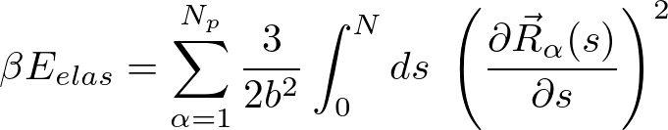



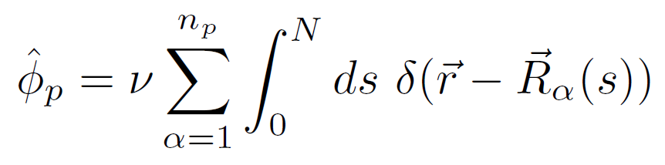
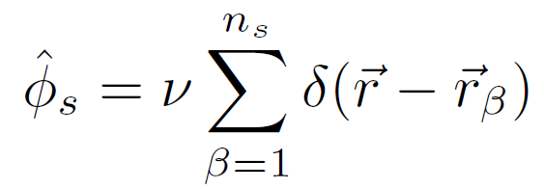
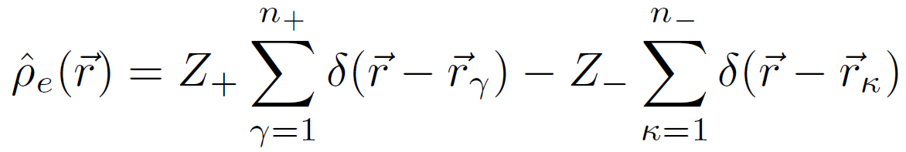
SCFT Derivation
Interactions
Operators (discrete particle locations)

Slide 6
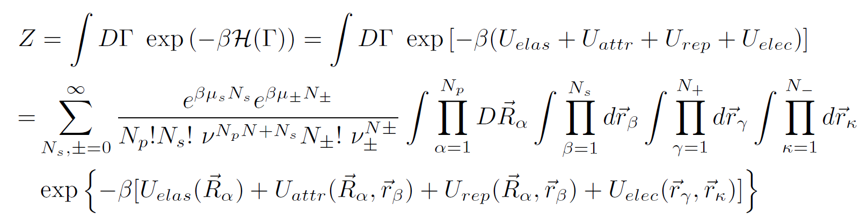
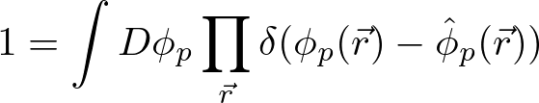
SCFT Derivation, cont.
Partition Function
Particle-to-Field Transformation
Hubbard-Stratonovich Transformation

Slide 7
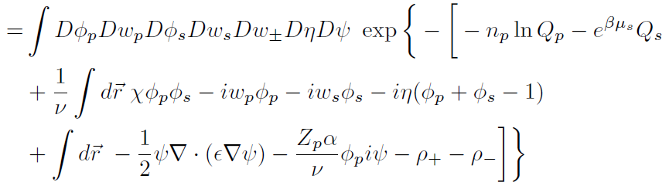
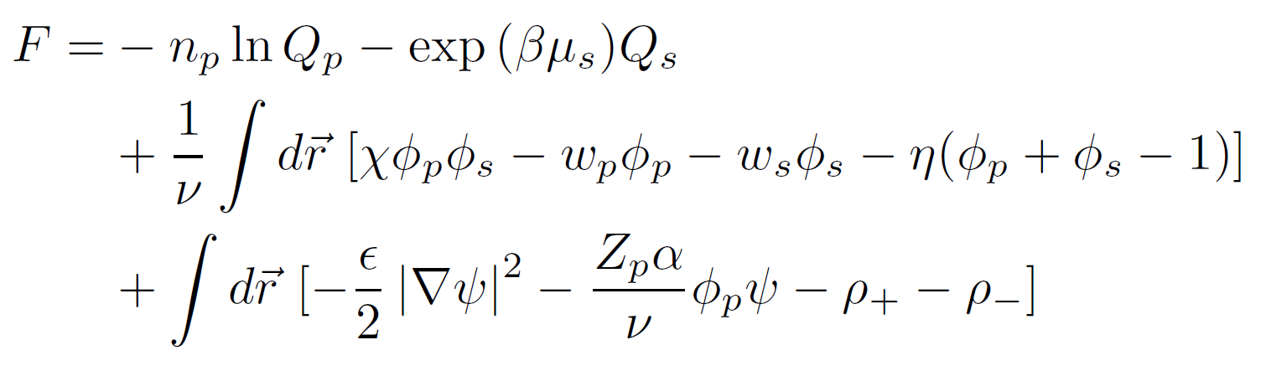
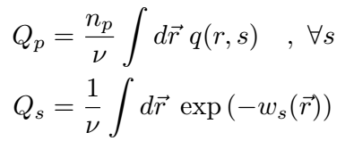
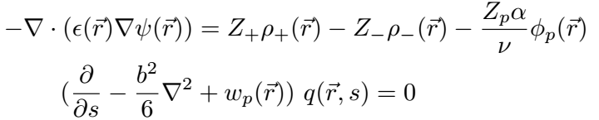

SCFT Derivation, cont.
Partition Function
Free Energy
(After Saddle-point Approximation)

Slide 8
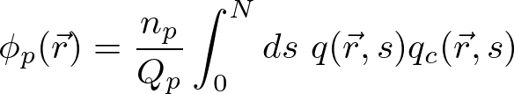

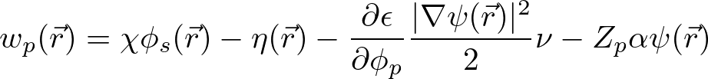

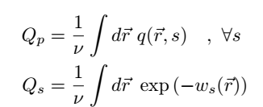
SCFT Derivation, cont.

Slide 9
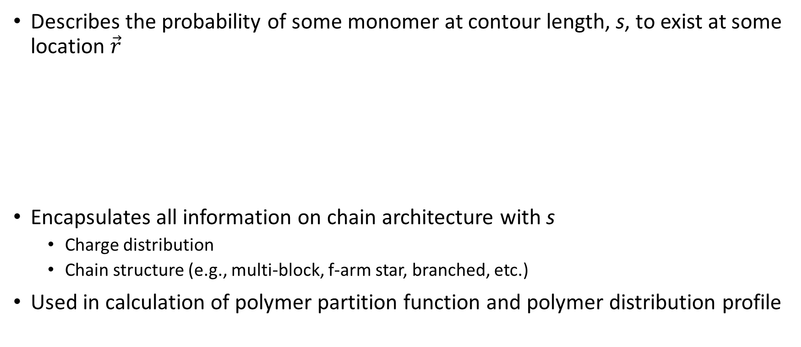
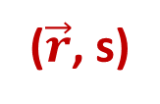
Single Chain Propagator
Describes the probability of some monomer at contour length, s, to exist at some location $\vec{r}$
Encapsulates all information on chain architecture with s
Charge distribution
Chain structure (e.g., multi-block, f-arm star, branched, etc.)
Used in calculation of polymer partition function and polymer distribution profile
($\vec{r}$, s)

Slide 10
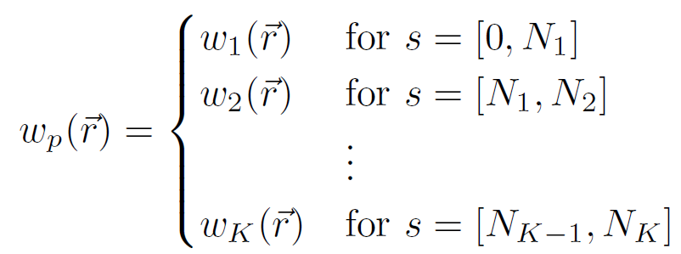



Single Chain Propagator, cont.
Solved by a modified diffusion equation:
Initial condition at s = 0 and s = N specifies locations of first and last monomers of block
When applied to a grafted chain,

Slide 11
Overview
Review of SCFT
Self-consistent Field Equations
Single chain propagator, q(r, s)
Neurofilament brush
Application of SCFT
Application to Real-world systems

Slide 12
Overview
Review of SCFT
Self-consistent Field Equations
Single chain propagator, q(r, s)
Neurofilament brush
Implication of brush inconsistencies on health
Proteins as block copolymers
Revised SCF Equations for NF brush
Application of SCFT
Application to Real-world systems

Slide 13
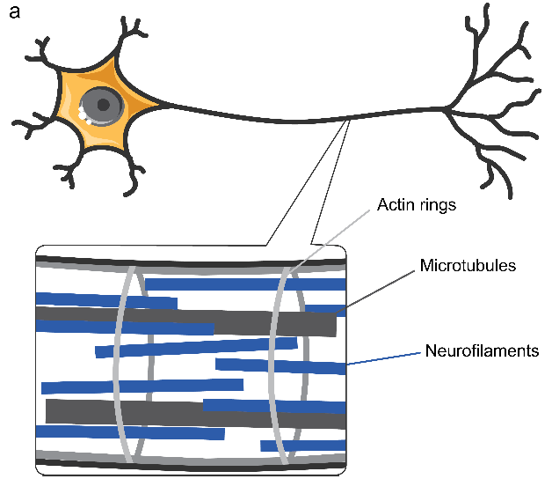
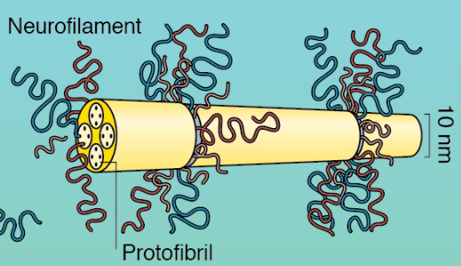
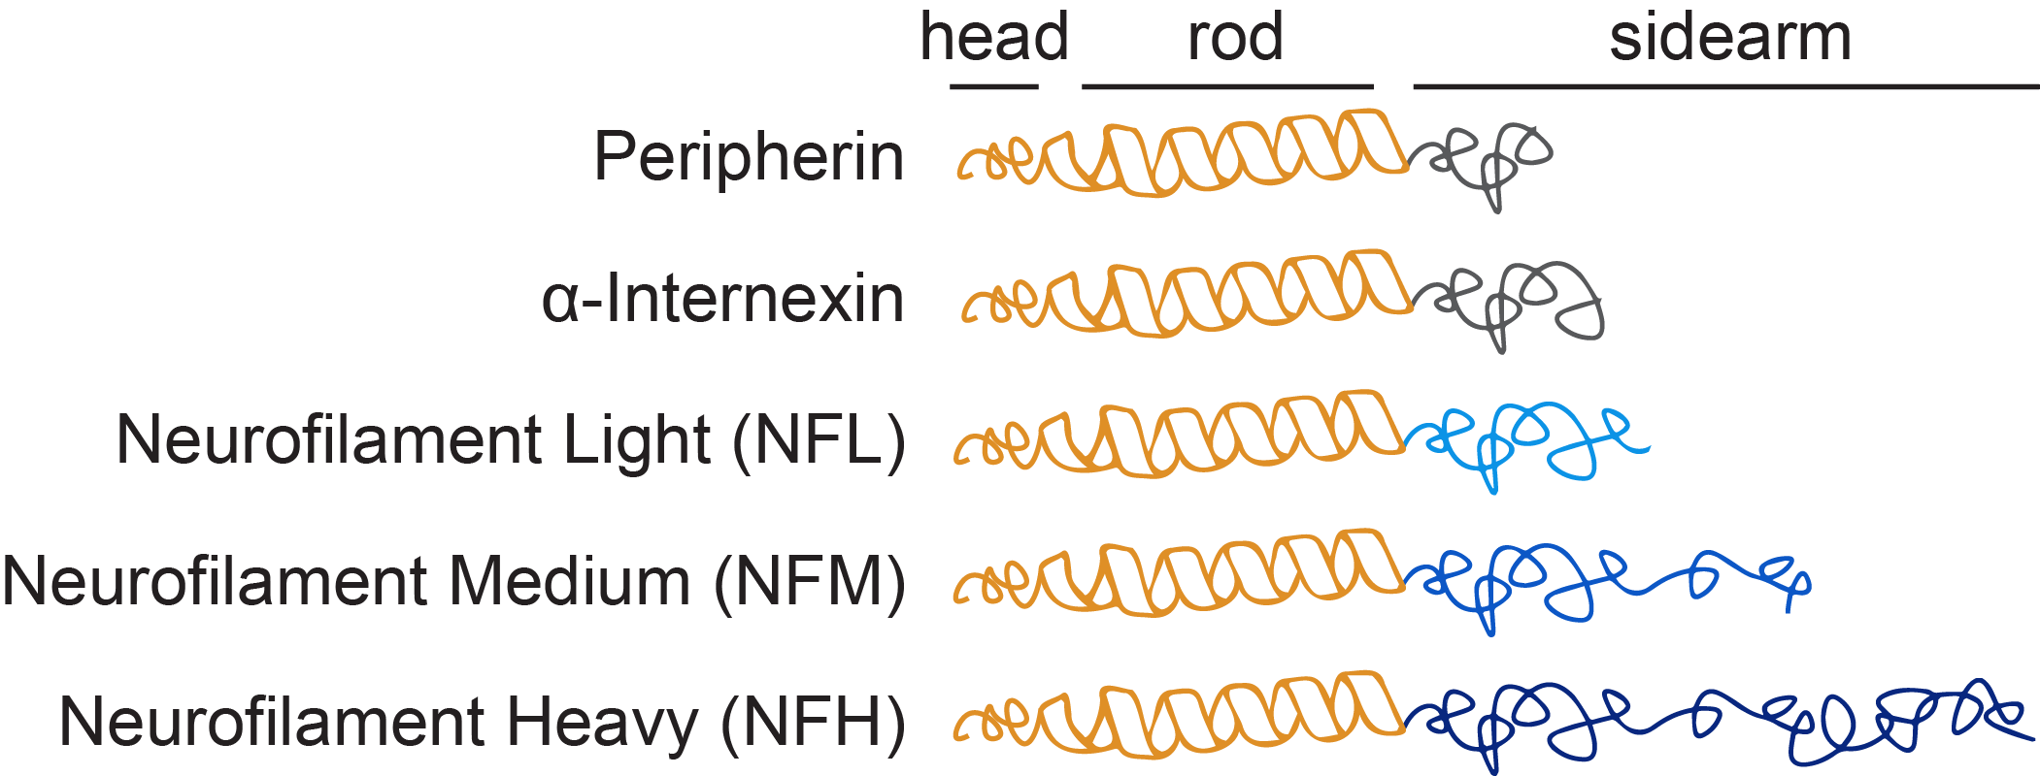
Neurofilaments
Resides in axon of neurons of vertebrates
Along with microtubules, form a stable matrix inside the axon
Controls rigidity and diameter size of axon
Composed of 3 main chain types:
Figure Credit: Erika Ding
Figure: Yuan, Rao, Nixon. (2012). Neurofilamnts at a Glance. J Cell Sci. 125 (14): 3257–3263.
Figure Credit: Erika Ding
Notes:
Hermann, H., & Aebi, U. (2016). Intermediate filaments: Structure and assembly. Cold Spring Harbor Perspectives in Biology, 8(11), a018242

Slide 14
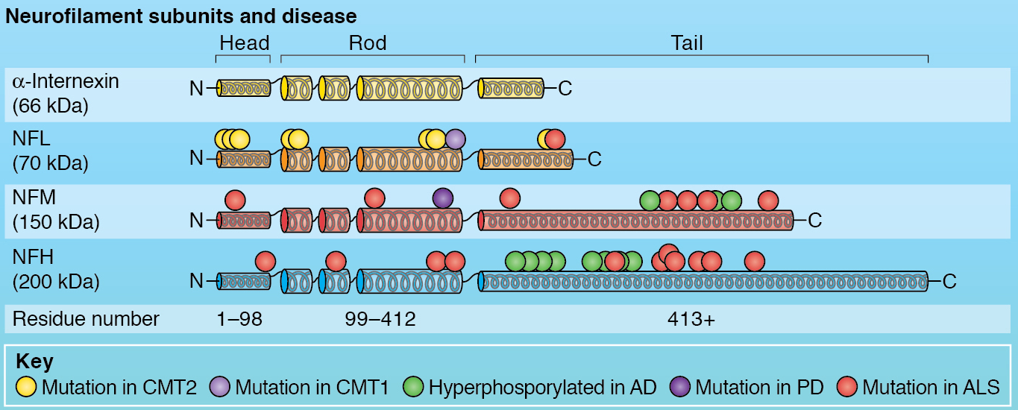
NF Health Implications
Neurodegeneration: Destruction/loss of function of neurons
Increased NF levels outside of neurons in diseases such as Alzheimer, Parkinson, Huntington, dementia, ALS.¹
(1) Bridel, et al. (2019). Diagnostic Value of Cerebrospinal Fluid Neurofilament Light Protein in Neurology: A Systematic Review and Meta-Analysis. JAMA Neurology 76, no. 9: 1035–48.
Figure: Yuan, Rao, Nixon. (2012). Neurofilamnts at a Glance. J Cell Sci. 125 (14): 3257–3263.

Slide 15
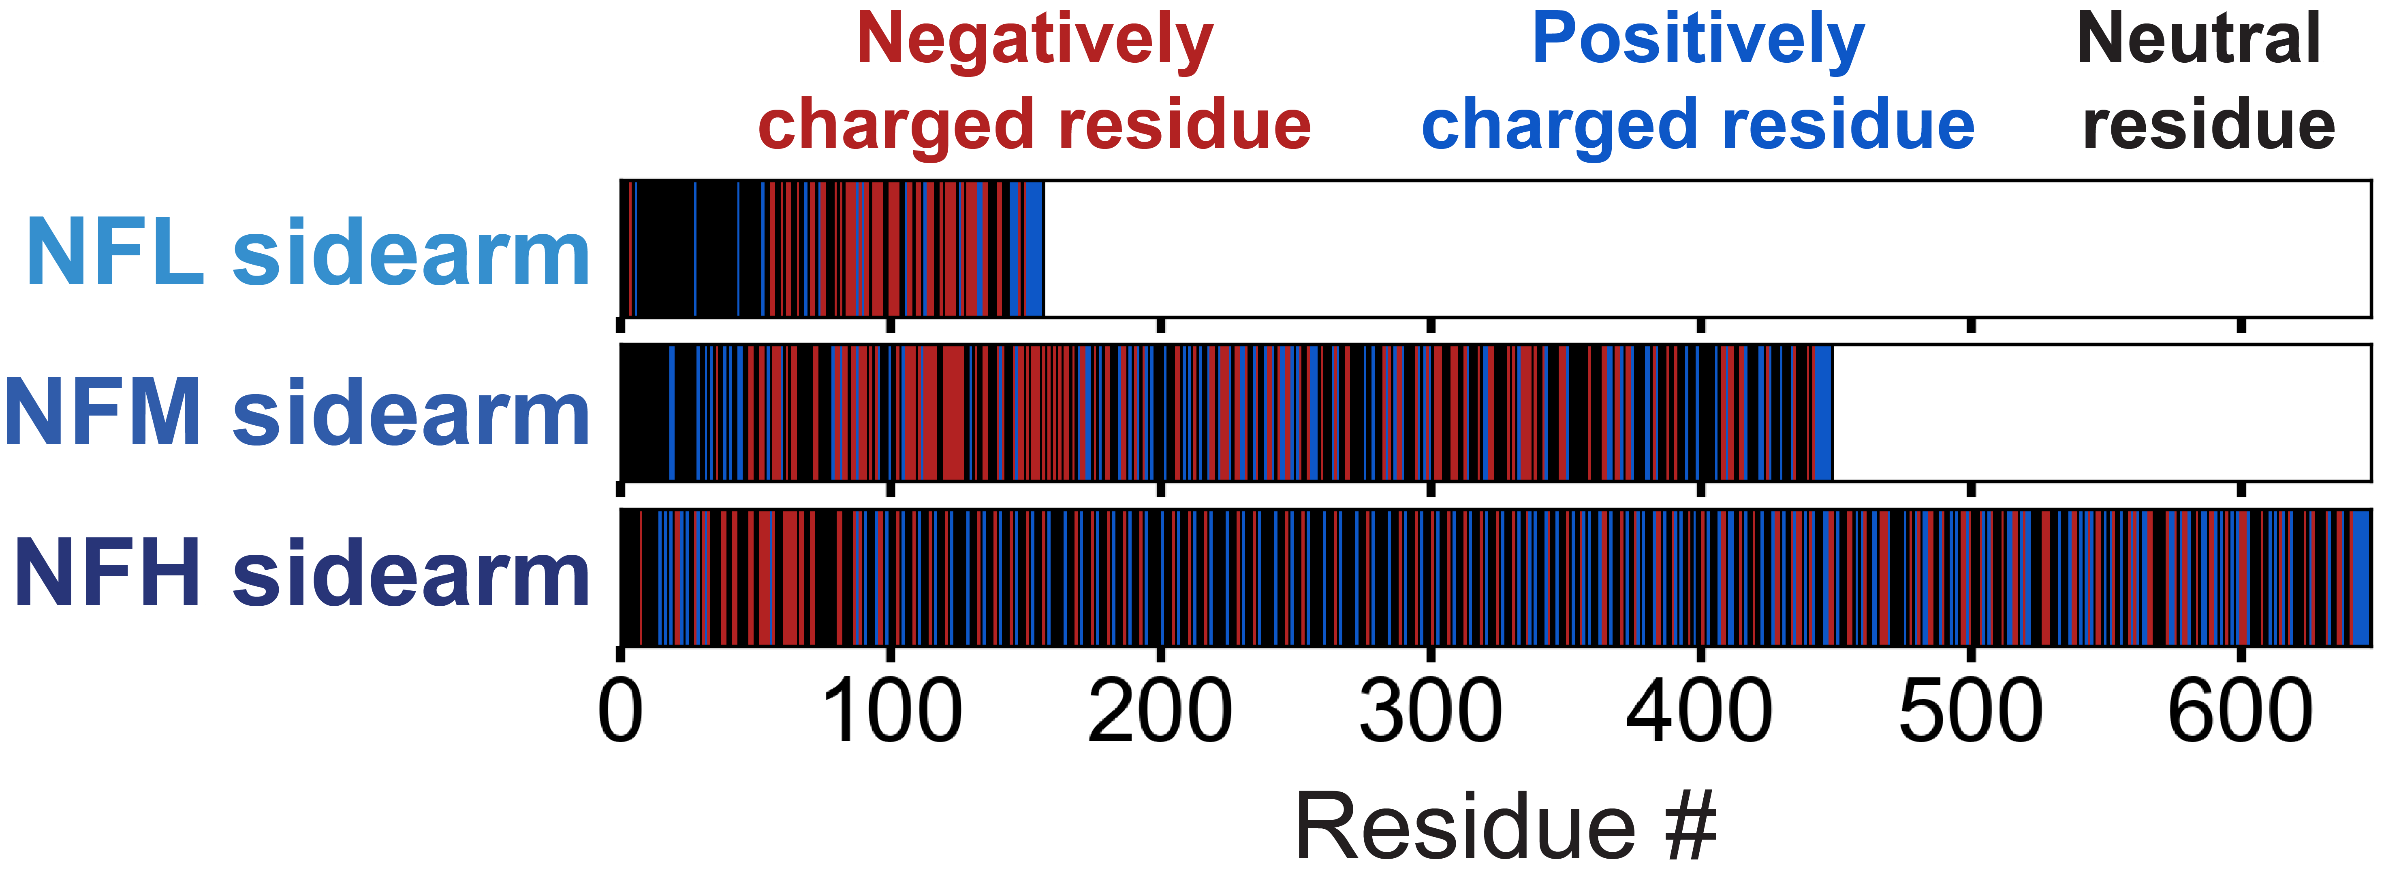
Proteins as block copolymers
Proteins have set amino acid sequences
The charges on each residue is dependent on surrounding pH
For each AA,
+ 1 when pH < pI_{AA}
-1 when pH > pI_{AA}
Physiological pH = 7.1
Each residue also has its own interaction parameters with solvent and all other residues
Previous SCFT work has reported χ_{i} from 0.0 to 2.0 (Zhulina 2007)
But, only considered for AA—Solvent interactions
Figure Credit: Erika Ding

Slide 16
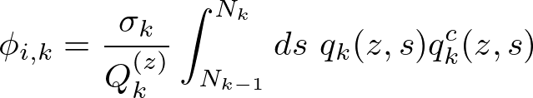
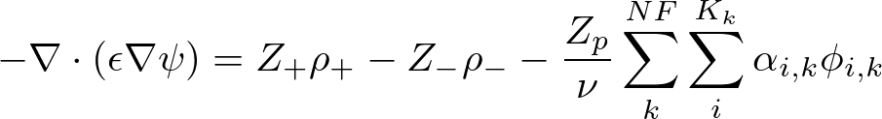


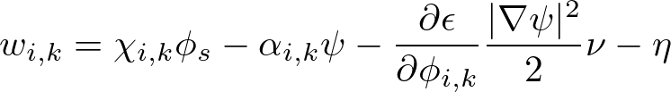

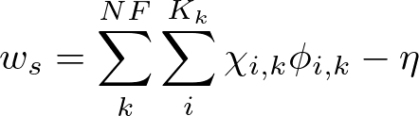

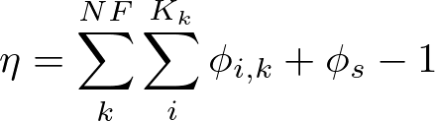
SCF Equations for NF (for NF number of chain types and K_{k} number of blocks per chain type)

Slide 17
Overview
Review of SCFT
Self-consistent Field Equations
Single chain propagator, q(r, s)
Neurofilament brush
Implication of brush inconsistencies on health
Proteins as block copolymers
Revised SCF Equations for NF brush
Application of SCFT
Application to Real-world systems

Slide 18
Overview
Review of SCFT
Self-consistent Field Equations
Single chain propagator, q(r, s)
Neurofilament brush
Implication of brush inconsistencies on health
Proteins as block copolymers
Revised SCF Equations for NF brush
Application of SCFT
Determining blocks
Comparison to Zhulina 2007
Application to Real-world systems

Slide 19
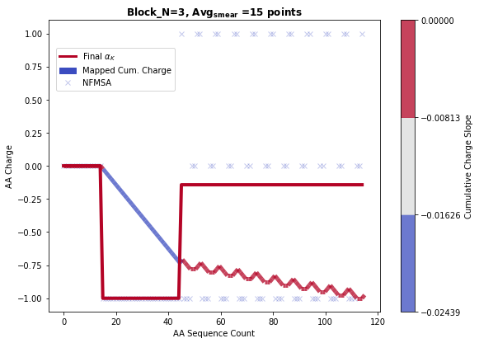
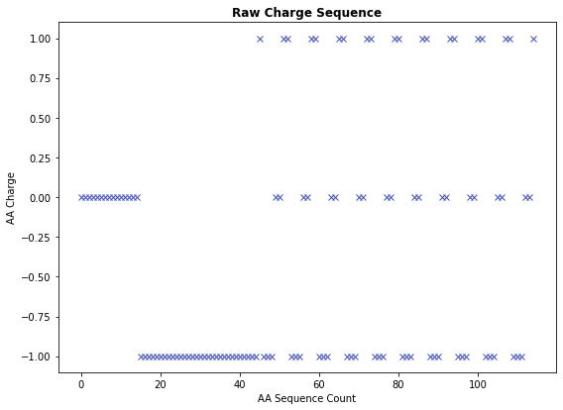
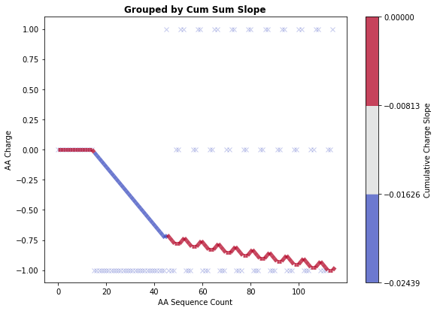
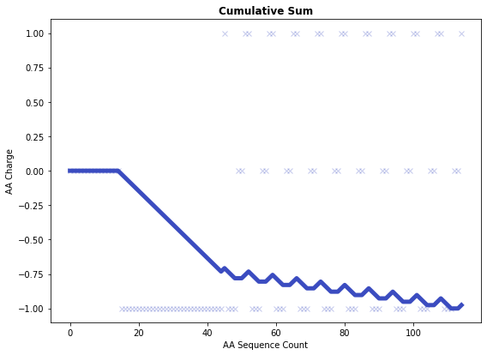
Converting AA → Blocks
Example sequence:
HHHHHHHHHHHHHHH DDDDDDDDDDDDDDDDDDDDDDDDDDDDDD
KDDDHHK KDDDHHK KDDDHHK KDDDHHK KDDDHHK KDDDHHK KDDDHHK KDDDHHK KDDDHHK KDDDHHK

Slide 20
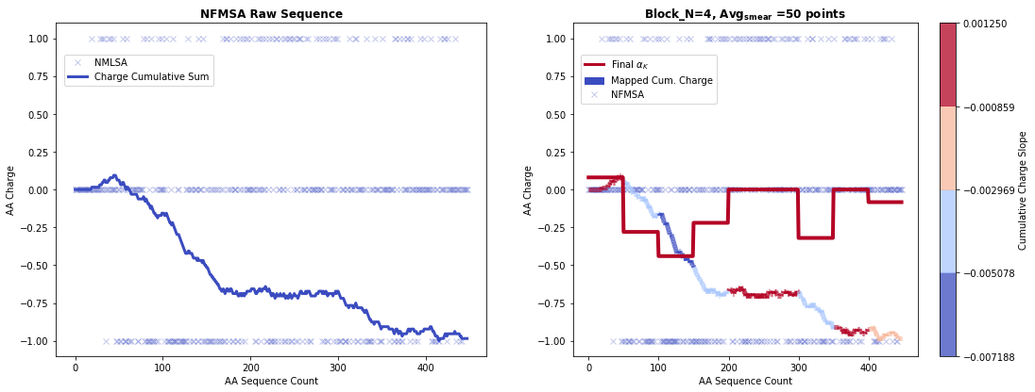
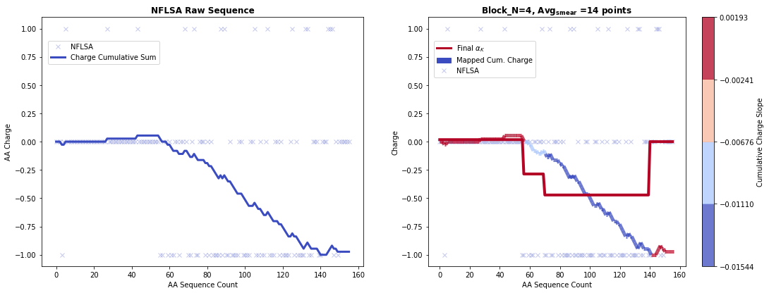
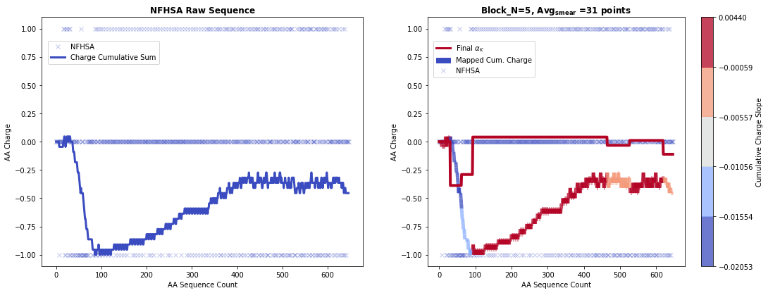
H0: Assuming all H residues neutrally charged

Slide 21
H0: Assuming all H residues neutrally charged

Slide 22


Comparison with Previously Reported SCFT
All subsequent references to “Zhulina” refer to: Zhulina, E.B., and F.A.M. Leermakers. (2007). A Self-Consistent Field Analysis of the Neurofilament Brush with Amino-Acid Resolution. Biophysical Journal 93, no. 5: 1421–30.
Zh
NFLSA
H0
Red: Negatively Charged Residue
Zh
NFMSA
Blue: Positively Charged Residue
H0
Black: Neutrally Charged Residue
Zh
NFHSA
H0
AA Sequence Count

Slide 23
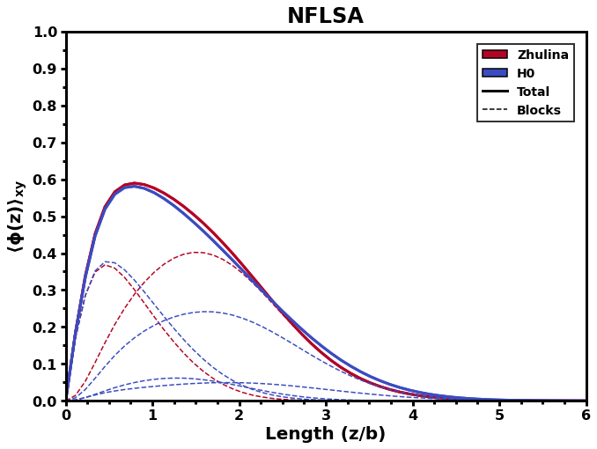



Block | H0 | Zh
1 | +0.0179 | +0.0400
2 | -0.2857 | -0.3585
3 | -0.4714
4 | 0.0000
 | Charge
H0 | Zh
1.0464 | 1.0840
0.7429 | 0.5660
0.5000
0.6375
Chi
Zhulina
H0

Slide 24
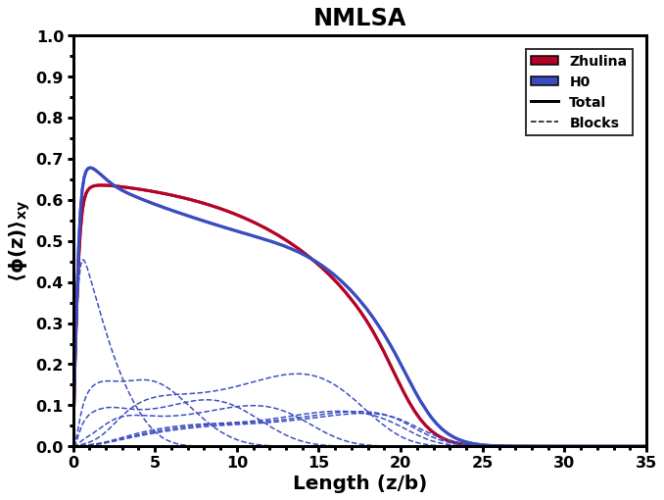
Block | H0 | Zh
1 | +0.0800 | -0.1406
2 | -0.2800
3 | -0.4400
4 | -0.2000
5 | 0.0000
6 | -0.3200
7 | 0.0000
8 | -0.0833
 | Charge
H0 | Zh
1.0120 | 0.7415
0.7400
0.5240
0.7280
0.6720
0.6680
0.8800
0.7792
Chi
Zhulina
H0

Slide 25
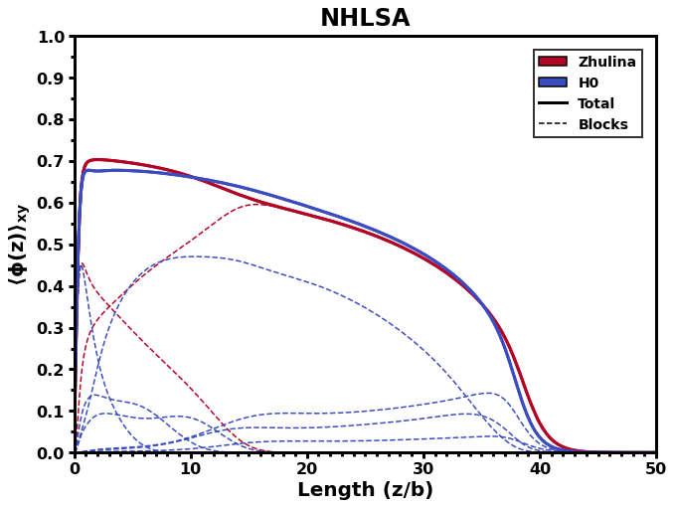
Block | H0 | Zh
1 | 0.0000 | -0.2100
2 | -0.3870 | 0.0256
3 | -0.2903
4 | +0.0403
5 | -0.0322
6 | +0.0103
7 | -0.1111
 | Charge
H0 | Zh
0.8581 | 0.7900
0.6516 | 0.9499
0.8903
1.0301
0.7452
0.6946
0.6593
Chi
Zhulina
H0

Slide 26
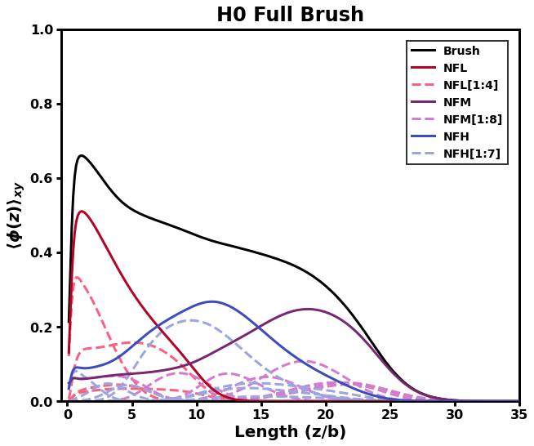
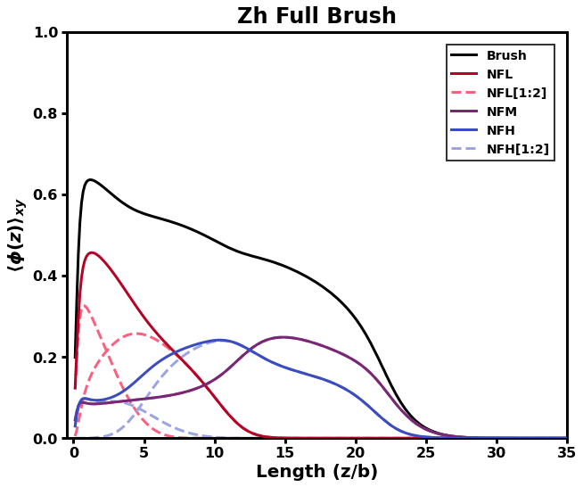
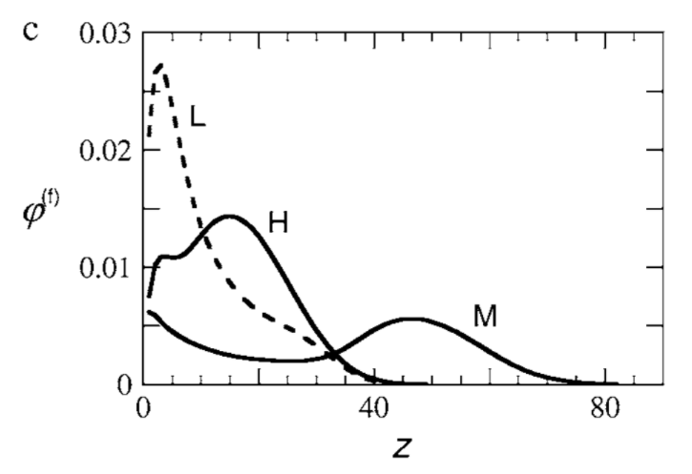
7:3:2 (L/M/H)
7:3:2 (L/M/H)
L
L
H
M
H = 31
H
M
H = 28.5
Zhulina, 2007
Differences:
Grafting density different
Contour length of AA = stiffness parameter
Notes:
H thresh at phA = 1e-03

Slide 27
Overview
Review of SCFT
Self-consistent Field Equations
Single chain propagator, q(r, s)
Neurofilament brush
Implication of brush inconsistencies on health
Proteins as block copolymers
Revised SCF Equations for NF brush
Application of SCFT
Determining blocks
Comparison to Zhulina 2007
Application to Real-world systems

Slide 28
Overview
Review of SCFT
Self-consistent Field Equations
Single chain propagator, q(r, s)
Neurofilament brush
Implication of brush inconsistencies on health
Proteins as block copolymers
Revised SCF Equations for NF brush
Application of SCFT
Determining blocks
Comparison to Zhulina 2007
Application to Real-world systems
Collaboration with Erika Ding and Prof. Sanjay Kumar
Avenues for other applications

Slide 29

Understanding Neurofilament Structure, Erika Ding, Prof. Sanjay Kumar
Start with easily implemented:
What is the role of the common positively charged block for all NFSA?
Use experiments to decide best interaction parameters
Currently, no AA—AA interactions
Matching Atomic Force Microscopy (AFM) results would provide basis for choosing interaction parameters ($χ_{ij}$)
NFLSA
NFMSA
NFHSA

Slide 30
Other applications (not necessarily with experimental collaboration)
NF systems:
Structural degradation of axon:
Self-assembly of dimers (NFL-NFL, NFL-NFM, etc.), then protofilaments, then protofibrils
Need to address rigidity of head and rod segments of each chain
What is the mechanism of NF degradation?
Brush systems
Consideration of Multivalency:
For divalent and above, we must consider both ion self-energies and ion correlation energies
Brushes will collapse as divalent salts associate onto the chains

Slide 31
Thank You!

